Slide 1

BCAAIML Computer Networks BCAAIML 403
PLEASE LEAVE THIS SPACE BLANK
Sonali Mondal
Assistant Professor CSIT
Kalinga University
Naya Raipur (C.G.), India

Slide 2
COURSE OBJECTIVES
Please remember the following text:-
To help students understand the network architecture, including hardware and software technologies, and to provide basic knowledge of data communication.-
To help students understand how networks work in terms of layered architecture, including a set of protocols and their implementation.-
To help students understand the practical aspects of Ethernet working based on IEEE standards.-
To help students understand the general principles of networking, including routing algorithms, Internet architecture, and addressing. Please remember the following text:-
To help students understand the network architecture, including hardware and software technologies, and to provide basic knowledge of data communication.-
To help students understand how networks work in terms of layered architecture, including a set of protocols and their implementation.-
To help students understand the practical aspects of Ethernet working based on IEEE standards.- To help students understand the general principles of networking, including routing algorithms, Internet architecture, and addressing.

Slide 3
COURSE OUTCOMES
The students will be able to understand the structure and organisation of computer networks, including the division into layers, the role of each layer, and the relationships between the layers.
The students will have a basic understanding of Communication techniques and the functioning of the physical layer.
The students will be able to understand the basic concepts of data link layer properties, including the flow control mechanisms.

Slide 4
CONTENTS
CLASS NAME MCA
Semester-IV
Paper Code – BCAAIML
SUBJECT NAME- Computer Network
S.No. | Unit-1
1 | Introduction
2 | Seven Layers of OSI Model
3 | Layer -7 to Layer 1
4 | Data Encapsulation
5 | OSI Model Analogy
6 | TCP/IP Model
7 | Transmission Media

Slide 5
REFERENCES/TEXT BOOKS
Text Books:
1. A.S. Tanenbaum " Computer Network: Second Ed. Prentice Hall, India(tan)
2. B.A. Frouzan, Data Communication, Tata McGraw Hill.
Reference Books:
1. D. Berekas and R. Gallager, " Data Networks", second Ed. Prentice Hall, India
2. D.E. Coner," Internetworking with TCP/IP", Vol-I. Prentice Hall India.

Slide 6
LECTURE PLAN
Lecture No. | Topics to be covered | Slide No.
L-1 | Introduction | 8-9
L-2-4 | Seven Layers of OSI Model | 10-14
L-5 | Layer -7 to Layer 1 | 15-27
L-6 | Data Encapsulation | 28-29
L-7-8 | OSI Model Analogy | 30-44
L-9 | TCP/IP Model | 45-64
L-10 | Transmission Media | 65-66
Quiz |  | 67-76

Slide 7
UNIT 1

Slide 8

The Open Systems Interconnection Basic Reference Model (OSI Reference Model or OSI Model) is an abstract description for layered communications and computer network protocol design. It was developed as part of the Open Systems Interconnection (OSI) initiative. In its most basic form, it divides network architecture into seven layers.
It is therefore often referred to as the OSI Seven Layer Model. Open Systems Interconnection (OSI) is a set of internationally recognized, non-proprietary standards for networking and for operating systems involved in networking functions.
8

Slide 9
To address the problem of networks increasing in size and in number, the International Organization for Standardization (ISO) researched many network schemes and recognized that there was a need to create a network model
This would help network builders implement networks that could communicate and work together
ISO therefore, Introduced the OSI reference model in 1978 and revised it in 1984.
9

Slide 10
Layer 7
Layer 6
Layer 5
Layer 4
Layer 3
Layer 2
Layer 1
Application
Presentation
Session
Transport
Network
Data Link
Physical
10

Slide 11
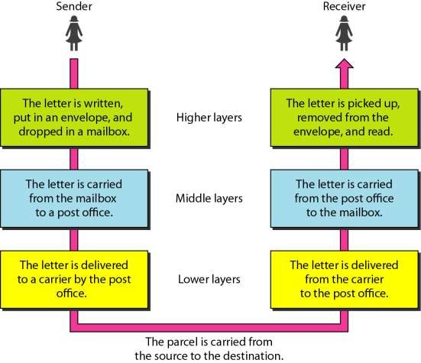
11

Slide 12




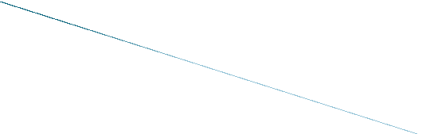
OSI Model's 7 Layers
APPLICATION
Application to Application
APPLICATION
PRESENTATION
Application to Application
PRESENTATION
SESSION
Application to Application
SESSION
TRANSPORT
Process to Process
TRANSPORT
NETWORK
Source to Destination
NETWORK
Router
Source to Destination
DATA LINK
Hop to Hop
Switch
DATA LINK
Hop to Hop
PHYSICAL
Hub and Repeater
PHYSICAL
Physical Medium
12

Slide 13









NODE A
Sending Device
NODE B
Receiving Device
Layer 7
Application Layer
Supports the communication between applications over the network
Layer 7
Application Layer
Layer 6
Presentation Layer
Presents data to the receiver in a form it recognises
Layer 6
Presentation Layer
Layer 5
Session Layer
Establishes a connection and terminates it when no longer required
Layer 5
Session Layer
Layer 4
Transport Layer
Acknowledges the flow of data including re-transmission where required
Layer 4
Transport Layer
Layer 3
Network Layer
Adds the appropriate network addresses to packets
Layer 3
Network Layer
Layer 2
Data Link Layer
Adds the MAC addresses to packets
Layer 2
Data Link Layer
Layer 1
Physical Layer
Transmits the data on the medium
Layer 1
Physical Layer
13

Slide 14











Application (Upper) Layers
Application
Presentation
Session
Transport
Network
Data-Link
Physical
Data Flow Layers
14

Slide 15
7 | Application
6 | Presentation
5 | Session
4 | Transport
3 | Network
2 | Data Link
1 | Physical
The top layer of the OSI model
Provides a set of interfaces for sending and receiving applications to gain access to and use network services. Processing.
This layer networking Examples:
deal with applications.
Email
Web browsers
15

Slide 16
7 | Application
6 | Presentation
5 | Session
4 | Transport
3 | Network
2 | Data Link
1 | Physical
This layer is responsible for presenting the data in the required format which may include:
Code Formatting/Translation
Encryption
Compression
16

Slide 17
Manages data-format information for networked communications (the network’s translator).
For outgoing messages, it converts data into a generic format for network transmission; for incoming messages, it converts data from the generic network format to a format that the receiving application can understand.
This layer is also responsible for certain protocol conversions, data encryption/decryption, or data compression/decompression.
A special software facility called a “redirector” operates at this layer to determine if a request is network related or not and forwards network-related requests to an appropriate network resource.
17

Slide 18
7 | Application
6 | Presentation
5 | Session
4 | Transport
3 | Network
2 | Data Link
1 | Physical
This layer establishes, manages, and terminates sessions between two communicating hosts.
Creates Virtual Circuit
Coordinates communication between systems
Organize their communication by offering three different modes
Simplex
Half Duplex
Full Duplex
18

Slide 19
 Enables two networked resources to hold ongoing communications (called a session) across a network
Applications on either end of the session are able to exchange data for the duration of the session
This layer is:
Responsible for initiating, maintaining and terminating sessions
Responsible for security and access control to session information (via session participant identification)
Responsible for synchronization services, and for checkpoint services

Slide 20
This layer breaks up the data from the sending host and then reassembles it in the receiver.
It provides reliable data
7 | Application
6 | Presentation
5 | Session
4 | Transport
3 | Network
2 | Data Link
1 | Physical
transport network.
Other
across the
features of this
layer are:
Sequencing
Acknowledgment
Retransmission
Flow Control
14

Slide 21
Manages the transmission of data across a network
Manages the flow of data between parties by segmenting long data streams into smaller data chunks (based on allowed “packet” size for a given transmission medium)
Reassembles chunks into their original sequence at the receiving end
Provides acknowledgements of successful transmissions and requests resends for packets which arrive with errors

Slide 22
7 | Application
6 | Presentation
5 | Session
4 | Transport
3 | Network
2 | Data Link
1 | Physical
End to End Delivery
Provide logical addressing that routers use for path determination
Internetwork Communication
Packet forwarding
Packet Filtering
Makes “Best Path Determination”
16

Slide 23
Handles addressing messages for delivery, as well as translating logical network addresses and names into their physical counterparts
Responsible for deciding how to route transmissions between computers
This layer also handles the decisions needed to get data from one point to the next point along a network path
This layer also handles packet switching and network congestion control

Slide 24
7 | Application
6 | Presentation
5 | Session
4 | Transport
3 | Network
2 | Data Link
1 | Physical
Performs Physical Addressing
This layer provides reliable transit of data across a physical link.
Access to media using MAC address
Error detection
LLC and MAC
Logical Link Control performs Link establishment
MAC Performs Access method
Preamble | DMAC | SMAC | Data length | DATA | FCS
18

Slide 25
Handles special data frames (packets) between the Network layer and the Physical layer
At the receiving end, this layer packages raw data from the physical layer into data frames for delivery to the Network layer
At the sending end this layer handles conversion of data into raw formats that can be handled by the Physical Layer

Slide 26
7 | Application
6 | Presentation
5 | Session
4 | Transport
3 | Network
2 | Data Link
1 | Physical
This is the physical media through which the data, represented as electronic signals, is sent from the source host to the destination host.
Move bits between devices
Encoding
20

Slide 27
Converts bits into electronic signals for outgoing messages.
Converts electronic signals into bits for incoming messages.
This layer manages the interface between the computer and the network medium (coax, twisted pair, etc.)
This layer tells the driver software for the MAU (media attachment unit, ex. network interface cards (NICs, modems, etc.)) what needs to be sent across the medium.
The bottom layer of the OSI model.

Slide 28

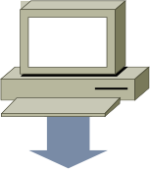


























Application
Presentation
Session
Transport
PDU
Upper-Layer Data
Segment
TCP Header
Upper-Layer Data
Network
Packet
IP Header
Data
LLC Header
Data
FCS
Data-Link
Frame
MAC Header Data
FCS
Physical
0101110101001000010
Bits

Slide 29

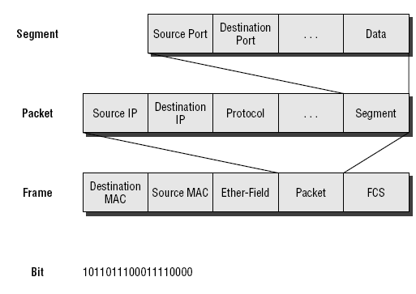

Slide 30

After riding your new bicycle a few times in Bangalore, you decide that you want to give it to a friend who lives in Delhi.

Slide 31


Make sure you have the proper directions to disassemble and reassemble the bicycle.

Slide 32


Call your friend and make sure you have his correct address.

Slide 33




Disassemble the bicycle and put different pieces in different boxes. The boxes are labeled
“1 of 3”, “2 of 3”, and “3 of 3”.

Slide 34


Put your friend's complete mailing address (and yours) on each box.Since the packages are too big for your mailbox (and since you don’t have enough stamps) you determine that you need to go to the post office.
2
8

Slide 35







Bangalore post office takes possession of the boxes.

Slide 36

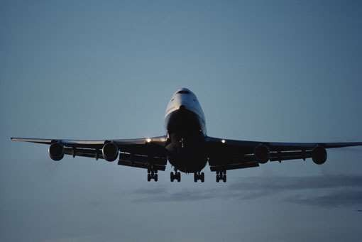
The boxes are flown from Bangalore to Delhi.

Slide 37



Delhi post office receives your boxes.

Slide 38

Upon examining the destination address, Delhi post office determines that your boxes should be delivered to your written home address.

Slide 39


Your friend calls you and tells you he got all 3 boxes and he is having another friend named BOB reassemble the bicycle.

Slide 40


Your friend hangs up because he is done talking to you.

Slide 41


BOB is finished and “presents” the bicycle to your friend. Another way to say it is that your friend is finally getting him “present”.

Slide 42

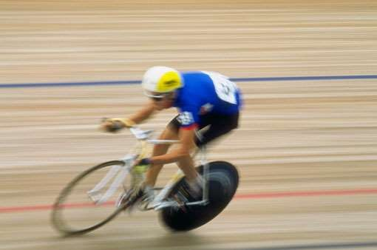
Your friend enjoys riding his new bicycle in Delhi

Slide 43
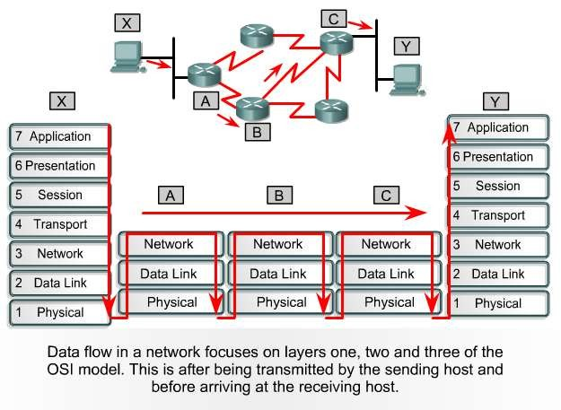

Slide 44

Although the OSI reference model is universally recognized, the historical and technical open standard of the Internet is Transmission Control Protocol / Internet Protocol (TCP/IP).
The TCP/IP reference model and the TCP/IP protocol stack make data communication possible between any two computers, anywhere in the world, at nearly the speed of light.
The U.S. Department of Defense (DoD) created the TCP/IP reference model because it wanted a network that could survive any conditions, even a nuclear war.

Slide 45


Process / Application Layer
Host-to-Host Layer
Internet Layer
Network Access Layer

Slide 46

Process/Application Layer
The Process layer contains protocols that implements user level functions such as mail delivery, file transfer and remote login. This layer is actually the combination of upper three layers of OSI model i.e. Application, Presentation and Session.
Host-to Host Layer
The Host-to Host layer handles connection assignation, flow control, retransmission of lost data, and other generic data flow management.

Slide 47
Internet Layer
The Internet layer is responsible for delivering data across a series of different physical networks that interconnect a source and destination machine.
Routing protocols are most closely associated with
this layer, as is the IP Protocol, the internet’s
fundamental protocol.
Network Access Layer
The Network Access layer is responsible for delivering data over the particular hardware media in use.
Different protocols are selected from this layer,
depending on the type of physical network.

Slide 48
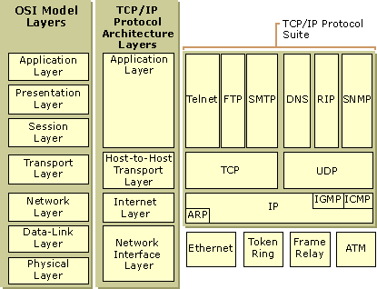

Slide 49


Bit 0
Bit 15
Bit 16
Bit 31
Source Port (16) |  |  | Destination Port (16)
Sequence Number (32)
Acknowledgment Number (32)
Header Length (4) | Reserved (6) | Code Bits (6) | Window (16)
Checksum (16) |  |  | Urgent (16)
Options (0 or 32 if Any)
Data (Varies)
20
Bytes
45

Slide 50















F T S D T S T E M N F N P L T S T M N P P P
E T
R I P
Application
Layer
21
23
25
53
69
161
520
Port Numbers
Transport
Layer
TCP
UDP
46

Slide 51















Source
Port
Destination
Port
…
Telnet Z
Host A
Host Z
SP
DP
Destination port = 23. Send packet to my Telnet
application.
1028 23 …

Slide 52

Windowing in networking means the quantity of data segments which is measured in bytes that a machine can transmit/send on the network without receiving an acknowledgement.

Slide 53

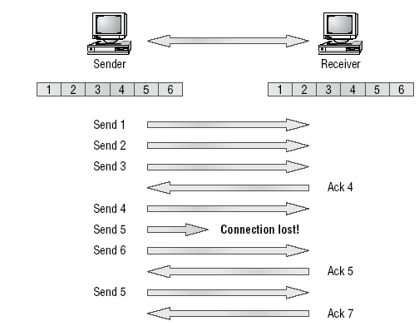

Slide 54

Another function of the transport layer is to provide optional flow control.
Flow control is used to ensure that networking devices don’t send too much information to the destination, overflowing its receiving buffer space, and causing it to drop the sent information
The purpose of flow control is to ensure the destination doesn't get overrun by too much information sent by the source

Slide 55
User Datagram Protocol (UDP) is the connectionless
transport protocol in the TCP/IP protocol stack.
UDP is a simple protocol that exchanges datagrams, without acknowledgments or guaranteed delivery. Error processing and retransmission must be handled by higher layer protocols.
UDP is designed for applications that do not need to put sequences of segments together.
The protocols that use UDP include:
TFTP (Trivial File Transfer Protocol)
SNMP (Simple Network Management Protocol)
DHCP (Dynamic Host Control Protocol)
DNS (Domain Name System)

Slide 56


Bit 0
Bit 15
Bit 16
Bit 31
1
Source Port (16) | Destination Port (16)
Length (16) | Checksum (16)
Data (if Any)
8
Bytes
 No sequence or acknowledgment fields
54

Slide 57



Bit 0
Bit 15 Bit 16
Bit 31
1
Version (4) | Header Length (4) | Priority &Type of Service (8) | Total Length (16)
Identification (16) |  |  | Flags (3) | Fragment Offset (13)
Time-to-Live (8) |  | Protocol (8) | Header Checksum (16)
Source IP Address (32)
Destination IP Address (32)
Options (0 or 32 if Any)
Data (Varies if Any)
20
Bytes

Slide 58



Transport Layer
TCP
UDP
6
17
Protocol Numbers
Internet Layer
IP
 Determines destination upper-layer protocol
57

Slide 59

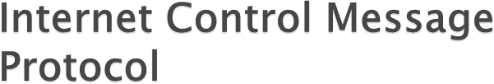



Application
Transport
1
ICMP
Destination Unreachable
Echo (Ping) Other
Internet
Data-Link
Physical
58

Slide 60














I need the Ethernet address of 176.16.3.2.
I heard that broadcast. The message is for me. Here is my Ethernet
address.
172.16.3.1
172.16.3.2
IP: 172.16.3.2 = ???
IP: 172.16.3.2
Ethernet: 0800.0020.1111
 Map IP
 Local ARP
MAC
60

Slide 61









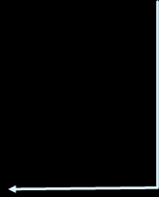





I heard that broadcast. Your IP address is 172.16.3.25.
What is my IP
address?
Ethernet: 0800.0020.1111 IP = ???
Ethernet: 0800.0020.1111
IP: 172.16.3.25
 Map MAC
IP
61

Slide 62

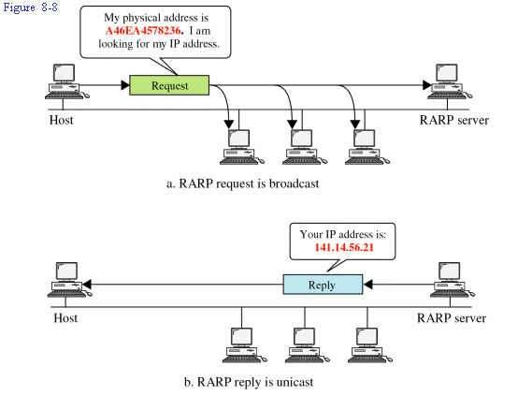
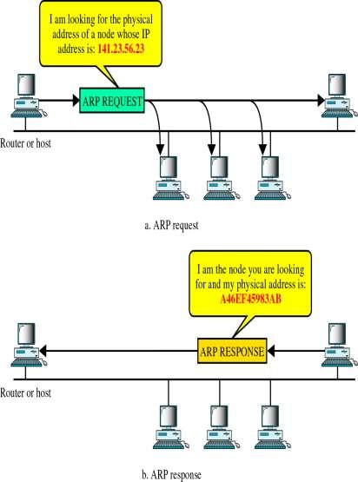
61

Slide 63

It is a logical construct that identifies a specific process or a type of service.
A port is always associated with an IP address of a host and
the protocol type of the communication, and thus completes the
destination or origination address of a communications session.
0-1023
1024-49151
49152-65535
Common TCP/UDP ports
53-DNS
well known ports registered ports
private or dynamic ports
161-SNMP
531-AOL INSTANT MESSENGER WELL KNOWN PORTS
21-FTP,23-TELNET,25-SMTP,80-HTTP,110-POP3,194-IRC,443-SECURE HTTP
REGISTERED PORTS
1863-MSN MESSENGER,2000-CISCO SCCP,8008-ALTERNATE HTTP,8080-ALTERNATE HTTP

Slide 64
OSI(Open System Interconnection) | TCP/IP(Transmission Control Protocol / Internet Protocol)
1. OSI provides layer functioning and also defines functions of all the layers. | 1. TCP/IP model is more based on protocols and protocols are not flexible with other layers.
2. In OSI model the transport layer guarantees the delivery of packets | 2. In TCP/IP model the transport layer does not guarantees delivery of packets.
3. Follows horizontal approach | 3. Follows vertical approach.
4. OSI model has a separate presentation layer | 4. TCP/IP does not have a separate presentation layer
5. OSI is a general model. | 5. TCP/IP model cannot be used in any other application.
6. Network layer of OSI model provide both connection oriented and connectionless service. | 6. The Network layer in TCP/IP model provides connectionless service.
7. OSI model has a problem of fitting the protocols in the model | 7. TCP/IP model does not fit any protocol
8. Protocols are hidden in OSI model and are easily replaced as the technology changes. | 8. In TCP/IP replacing protocol is not easy.
9. OSI model defines services, interfaces and protocols very clearly and makes clear distinction between them. | 9. In TCP/IP it is not clearly separated its services, interfaces and protocols.
10. It has 7 layers | 10. It has 4 layers

Slide 65
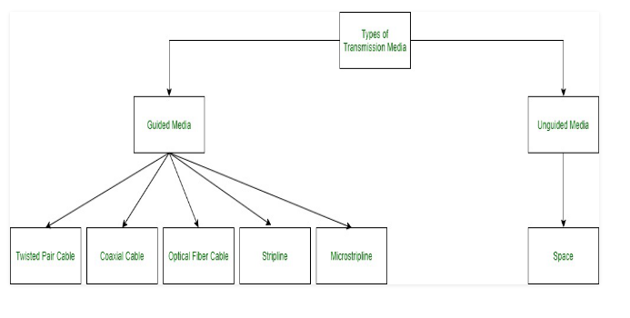
Transmission Media

Slide 66
Interconnection Devices
Router
Gateways
Bridges
Hubs

Slide 67
Multiple Choice Questions
1 OSI stands for __________
Open System Interconnection Operating System Interface Optical Service Implementation Open Service Internet
2. The number of layers in ISO OSI reference model is __________ 4 5 6 7

Slide 68
Multiple Choice Questions
3.TCP/IP model does not have ______ layer but OSI model have this layer. Session Layer Transport Layer Application Layer Network Layer
4. Which layer is used to link the network support layers and user support layers? Session Layer Data Link Layer Transport Layer Network Layer

Slide 69
Multiple Choice Questions
5.Which address is used on the internet for employing the TCP/IP protocols? Physical Address And Logical Address Port Address Specific Address All Of The Mentioned
6. TCP/IP model was developed _____ the OSI model. Prior To After Simultaneous To With No Link To

Slide 70
Multiple Choice Questions
7. Which layer is responsible for process to process delivery in a general network model? Network Layer Transport Layer Session Layer Data Link Layer
8. Which address is used to identify a process on a host by the transport layer? Physical Address Logical Address Port Address Specific Address

Slide 71
Multiple Choice Questions
9. Which layer provides the services to user? Application Layer Session Layer Presentation Layer
None of the above
10. Transmission data rate is decided by ____________ Network Layer Physical Layer Data Link Layer Transport Layer

Slide 72
Multiple Choice Questions
11. The sharing of a medium and its link by two or more devices is called _________ Fully duplexing Multiplexing Micropleixng Duplexing
12.Multiplexing is used in _______ Packet switching Circuit switching Data switching Packet & Circuit switching

Slide 73
Multiple Choice Questions
13.Which multiplexing technique used to transmit digital signals? FDM TDM WDM FDM & WDM
14.Multiplexing provides _________ Efficiency Privacy Anti jamming Both Efficiency & Privacy

Slide 74
Multiple Choice Questions
15. In TDM, slots are further divided into _________ Seconds Frames Packets Bits
16.The ground station in VSAT communication is called
Hub
HTTP
Multiplexer
Repeater

Slide 75
Multiple Choice Questions
17.____ units) in a single bus structure communicate at a time.
One
Two
Three
Four
18.Where does bridge operate in OSI model?
Application layer
Data link layer
Physical layer
Both a and b

Slide 76
Multiple Choice Questions
19.Encryption and Decryption are the functions of ___ layers.
Transport
Session
Presentation
Physical
20.Which layer 4 protocol is used for a Telnet connection?
TCP
IP
UDP
TCP/IP

